Slide 1

Dimensionality Reduction
Machine Learning II

Slide 2

Prerequisites

Slide 3

Checklist
Linear Algebra
Vector
Matrix
Rank, trace, condition number
Norm vs Distance
Eigenvalues/Eigenvectors
Invertibility

Slide 4
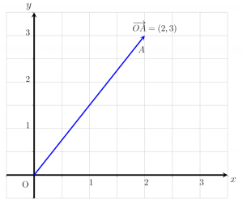
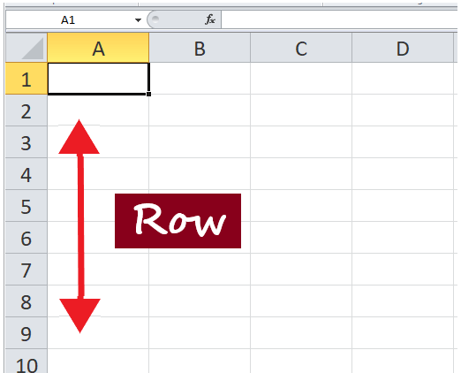

Vectors
Denote a point in space
Have magnitude and direction
Often represented with arrows
v = [dim1, dim2, dim3…]

Slide 5
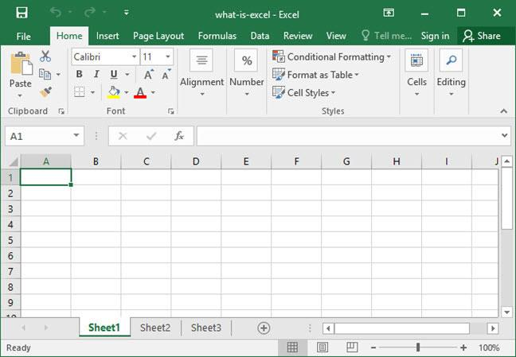
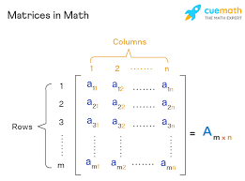
Matrices
Denote a set of vectors
Can create vector spaces and transformations to vectors
Similar to data tables

Slide 6
Introduction

Slide 7
Why do we need DR?

Slide 8
Use Cases
Compression

Slide 9
Use Cases
Compression
Feature extraction (vs feature selection)

Slide 10
Use Cases
Compression
Feature extraction (vs feature selection)
Visualization

Slide 11
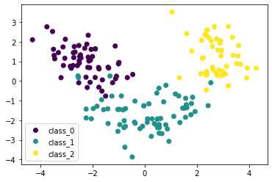
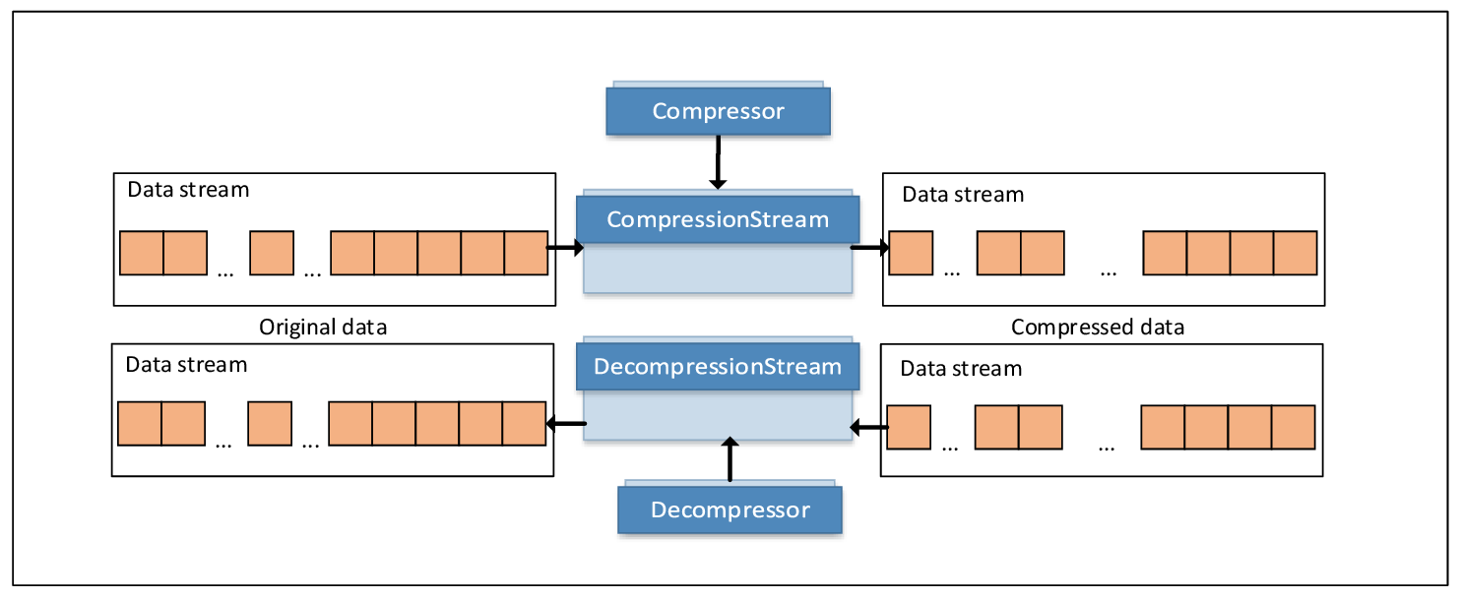
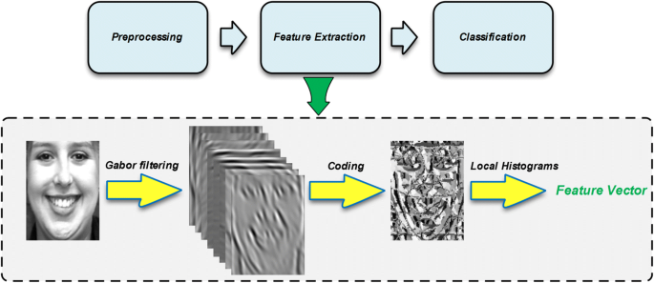
Use Cases
Compression
Feature extraction (vs feature selection)
Visualization

Slide 12
Let’s get started!

Slide 14
Spectral Decomposition
Equivalent to an Eigendecomposition of any matrix A_mxn
Eigenvector components are not always orthogonal
For this to happen, A_nxn is required (which is not always the case)

Slide 16
Singular Value Decomposition
Equivalent to a 3-factor decomposition of the matrix B=A’A, given any matrix A_mxn
A’A has always non-negative eigenvalues :D
sqrt(eigv(B)) == sv(A)
sv(A) == sv(A’) - why is this useful?
svd(A_c) ~ eig(B)
Eigenvalues yield the variance of the projection of the data on the eigenvector

Slide 17
Singular Value Decomposition
Allows partial reconstruction of original data (truncation)
Singular values act as Fourier coefficients when induced from a Frobenius norm (inner product)
Its components form an orthogonal basis

Slide 19
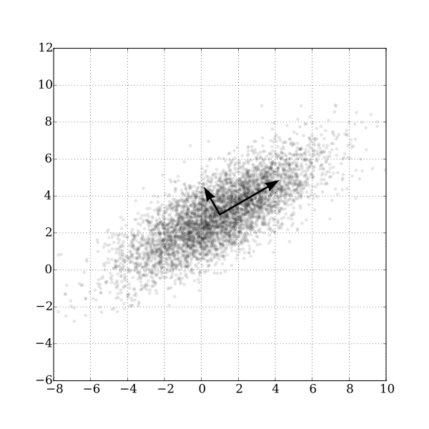
Principal Component Analysis
Linear method
PC: vectors carrying the largest variance (information) from the original data
Can be truncated to the n-largest principal components
Can be computed from either svd(A) or eig(B) - what does this depend on?

Slide 20
Principal Component Analysis
Linearly transforms the data into a new coordinate system where (most of) the variation in the data can be described with fewer dimensions than the initial data
(Sorted) PCs define the eigenvectors of the co-scattering/covariance/correlation matrix that mostly describe the variability of the dataset
One of the main reasons to use PCA is to remove correlated features from the dataset (eigenvectors are orthogonal)

Slide 21
What do we use today?

Slide 23
t-distributed Stochastic Neighbor Embedding
Non-linear
Widely used nowadays
Assumes output joint distribution to be t-distributed with 1 d.o.f
This mitigates the crowding problem: representing very high-dim into lower spaces affects inner proximity perception

Slide 24
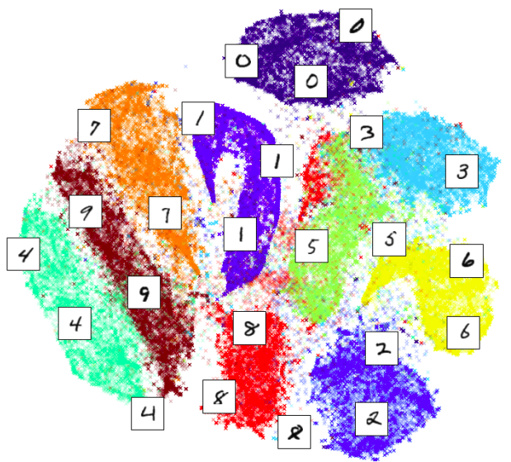
t-distributed Stochastic Neighbor Embedding

